Slide 1
WELCOME TO THE PROJECT 200
My Project is simple website for
Metropolitan University

Slide 2
PLATFORM
HTML
CSS
PHP
MYSQL
JAVASCRIPT

Slide 3
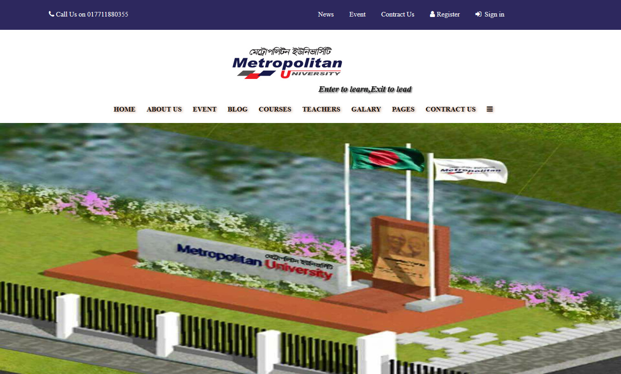
HOME PAGE

Slide 4
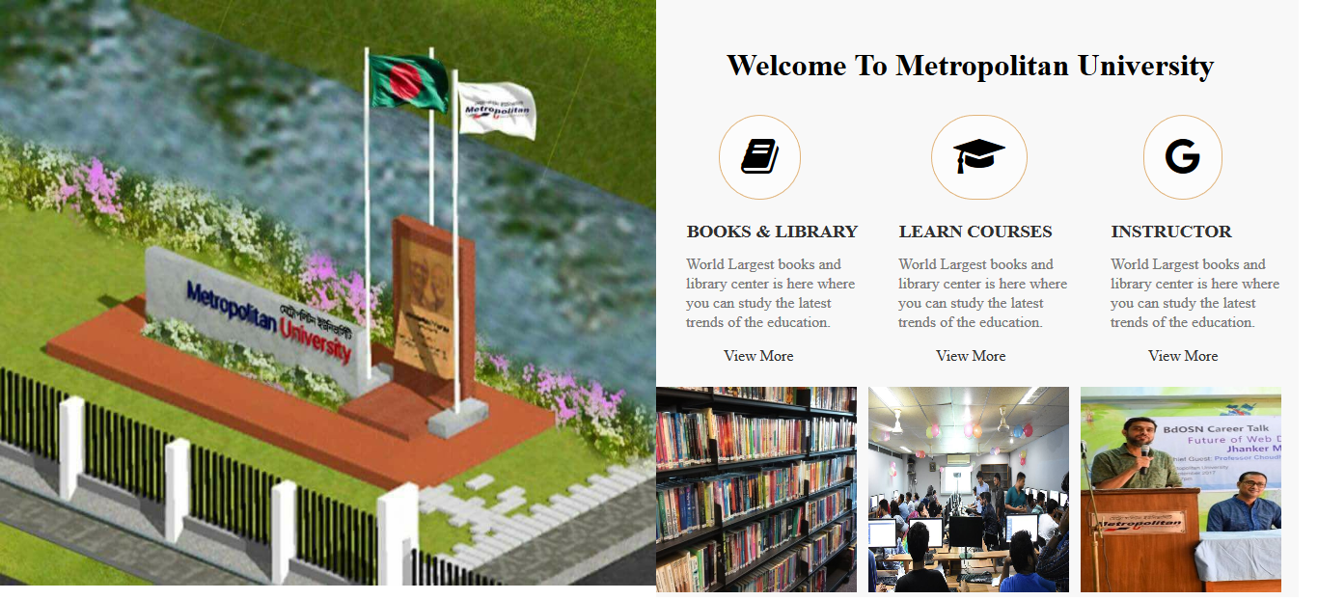
WELCOME MESSAGE

Slide 5
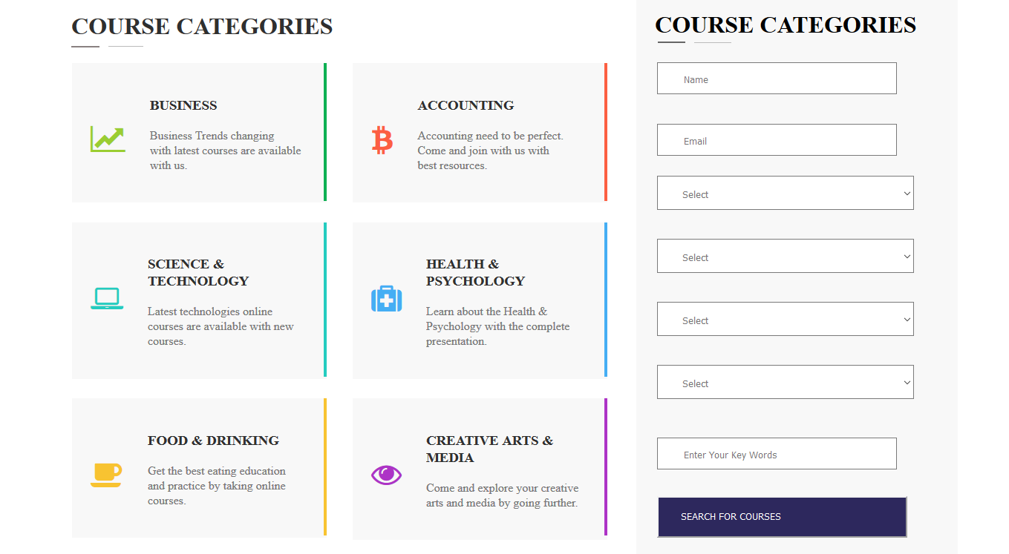
COURSE CATAGORIES

Slide 6
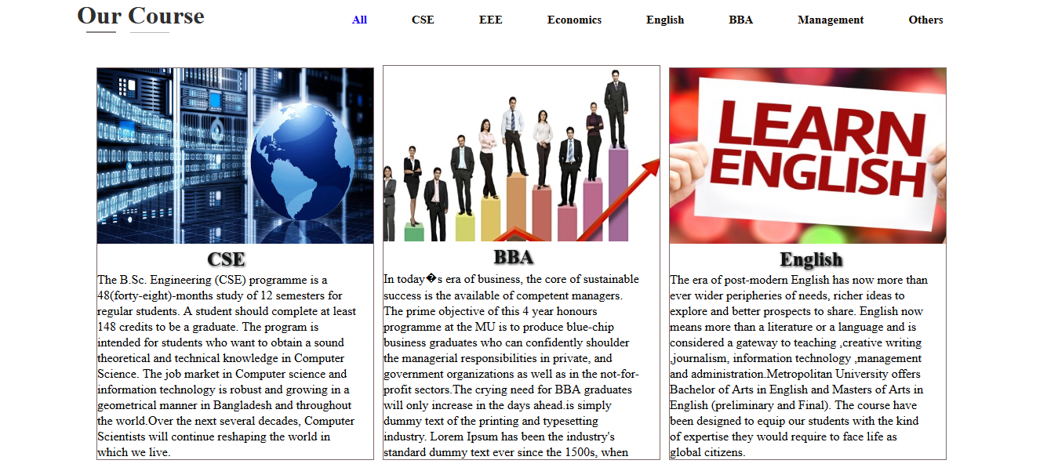
COURSE

Slide 7
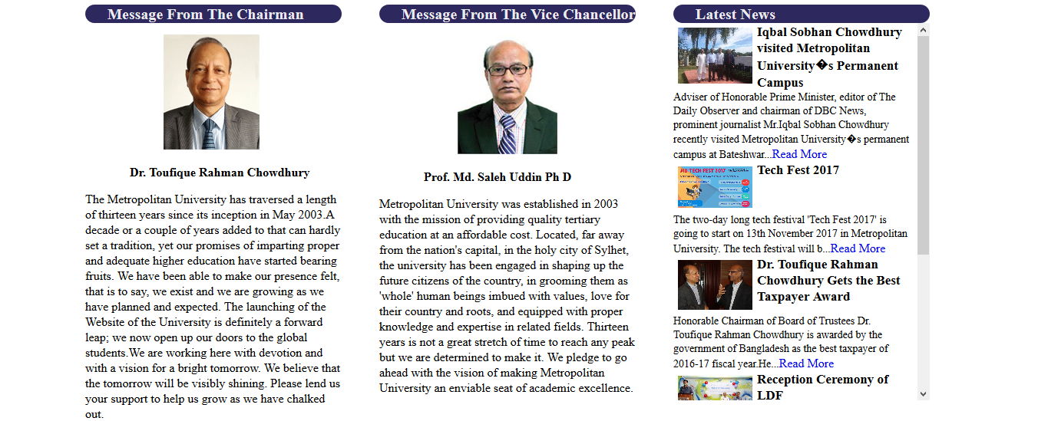
MESSAGES & NEWS

Slide 8
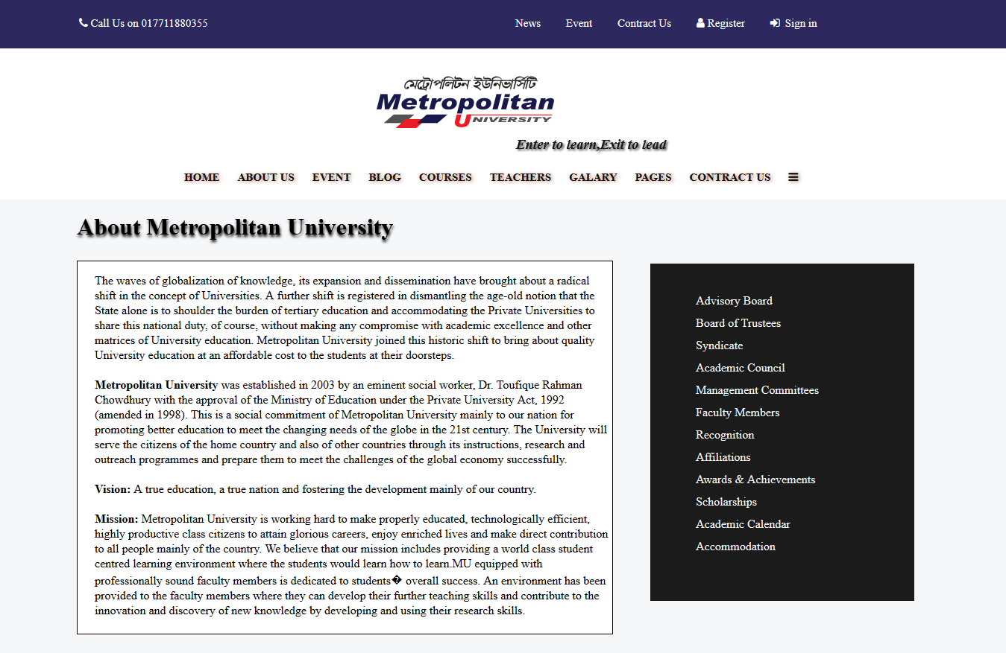
ABOUT US PAGE

Slide 9
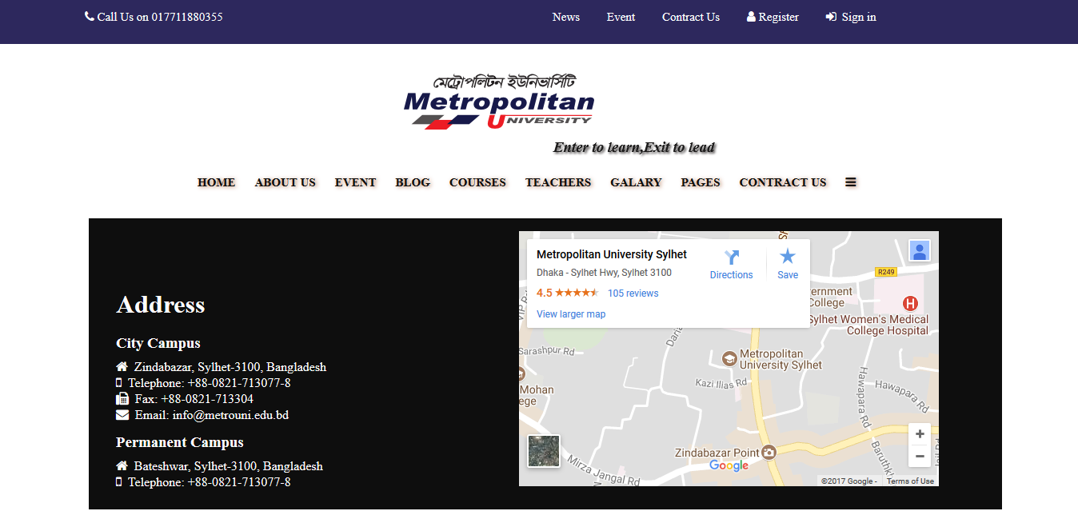
CONTRACT US PAGE

Slide 10
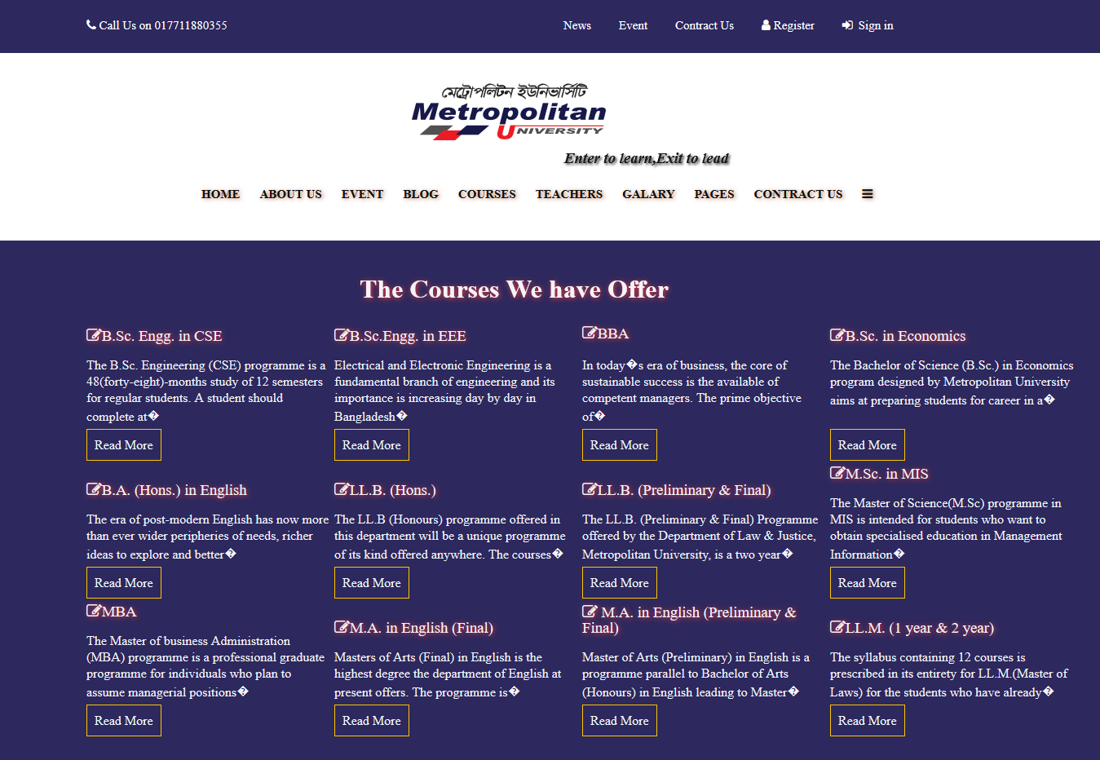
COURSES PAGE

Slide 11
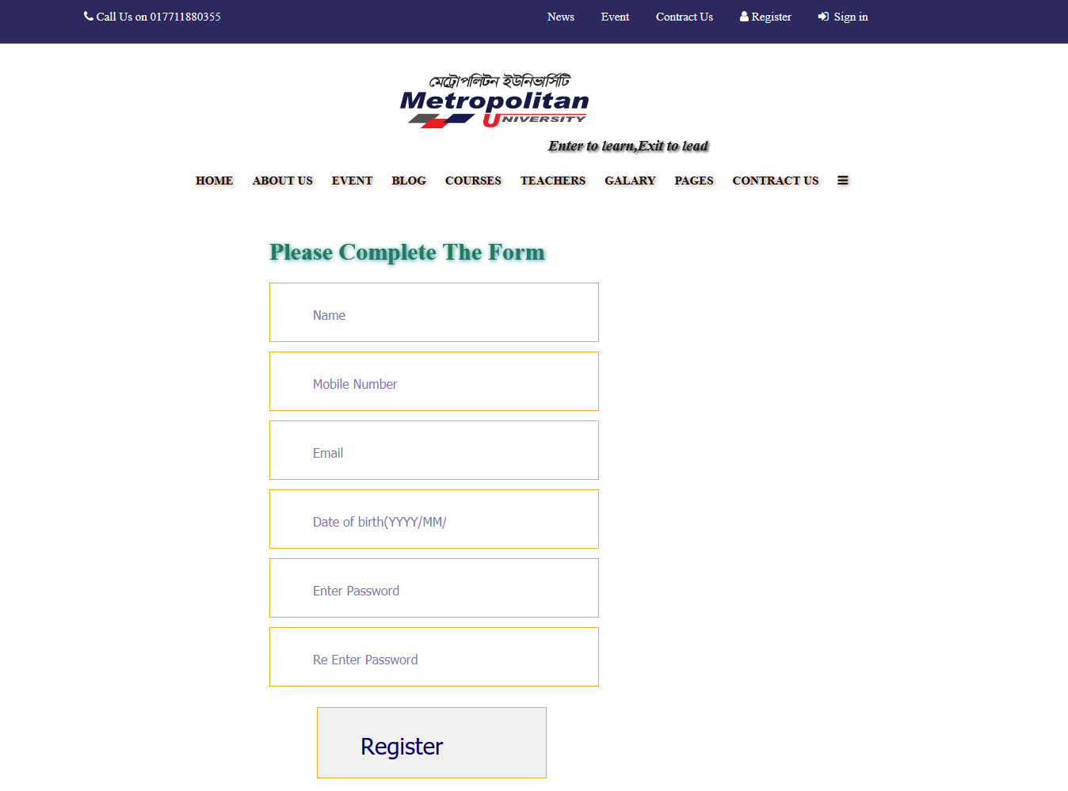
REGISTRATION PAGE

Slide 12
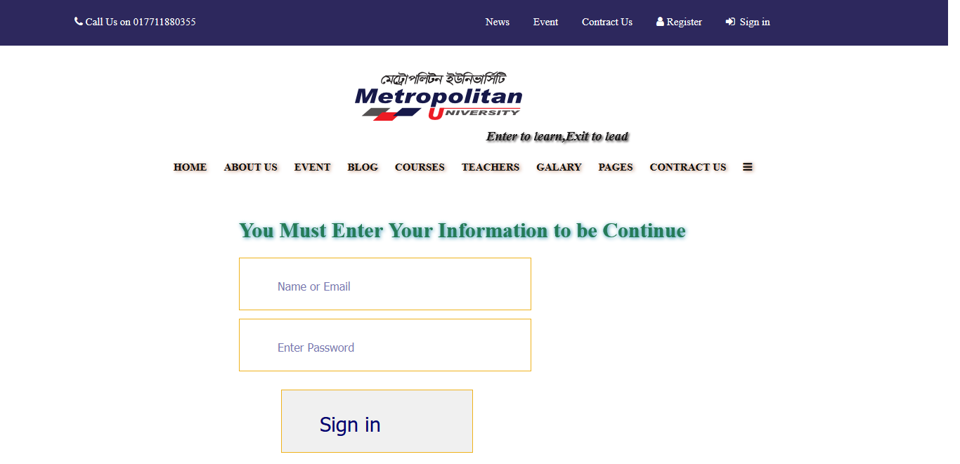
SIGN IN PAGE

Slide 13


